Slide 1


Group Case 4
–
BUMK 773
Team 3: Heven Abraha, Nia Bishop, Haotian Du, Rutendo Nyoka, Julia See

Slide 2

1
The tiered pricing structure is aligned with the product led growth strategy. The adoption barriers are lowered which creates a clear upgrade path from Basic to Pro prior to June 2022. The unlimited cover model targets consumers who are looking for a clear and direct option through simplifying the customer proposition. The differentiated SMS option provides a mechanism to easily upsell to potential consumers. The tiered pricing model’s additions in February 2024 allow high volume restaurants additional monetized options, reducing cost risks. The usage based monetization heightens consumer choice through the “free” and “starter” options. Large restaurant groups may benefit from having access to personalized tiers. Eat App would be able to maintain low friction consumer acquisition while revenue is aligned with values and variable costs depending on the market.
The free tier is essential for customer acquisition, the starter tier allows for monetization, the essential tier is the core consumer and the pro tier is for high value consumers. Eat App’s tiered structure involves several pricing dimensions including the subscription fee, covers, SMS messages, and features which heightens complexity. The gross margins can be protected if SMS was priced as a usage based variable. The free tier allows adoption friction to be reduced. Essential’s unlimited covers may capture more value, without the incentive of upgrading to Pro, while the large annual discounts reduce revenue capture. SMS should be moved to usage-based pricing because its variable cost can exceed Eat App’s fixed subscription economics. Large enterprise consumers such as Four Seasons should receive customized contracts as opposed to being placed in the standard tier structure.
Q1. Assess Eat App’s tiered pricing structure, as shown in case Exhibit 7a (free, starter, essential, pro). Are the tiers and price points aligned with the startup’s strategic goals? Would you suggest any changes?

Slide 3
2
The strategy recommendation would be a hybrid strategy: reduce the free SMS quotas by 50% and replace the current two-country pricing categories with five cost-based fixed-price categories. I would not eliminate free SMS, substantially increase subscription prices, or move immediately to fully variable pricing. This gives Eat App a way to improve SMS profitability while maintaining the simple and predictable pricing that would support its product and then lead to a growth strategy.
Q2. Eat App is losing money on SMSs in many markets. Use the data in case Exhibits 11a and 11b to evaluate the impact of reducing or eliminating SMS quotas in existing tiers, increasing fixed rates, expanding the number of country categories, and switching to cost-based variable pricing. Which strategy do you recommend (if any) and why?

Slide 4
2
The free SMS allowance would be reduced by 50% amongst each subscription tier. The reduction would decrease Eat App’s exposure to SMS costs while maintaining the value proposition associated with SMS. The significant variation in SMS costs across countries (Exhibit llb) reduces the free allowance which is important in high cost markets. The option of retaining free SMS as opposed to eliminating the option, preserves the attractiveness and simplicity of the pre-existing tiers.
For the option involving lowering SMS quotas, indicate by how much you would consider reducing SMS messages available for free in each tier.

Slide 5
2
Exhibit 11b shows that Eat App’s current fixed-rate system doesn't adequately reflect the large differences in SMS costs across countries. Average SMS costs range from $0.01 in the United States to $0.57 in Russia, while Eat App generally charges only $0.06 or $0.10 per message. This causes substantial losses in high-cost markets such as Indonesia, Pakistan, Kuwait, and Russia.
To improve profitability while keeping pricing relatively simple for customers, I would expand the current two-category structure to five categories based on average SMS cost: (next slide)
Q2b. To evaluate the option involving adjusting fixed-rate category pricing, use the information in Exhibit 11b and propose up to 5 categories to classify the countries listed; indicate the price you propose per message in each category.

Slide 6
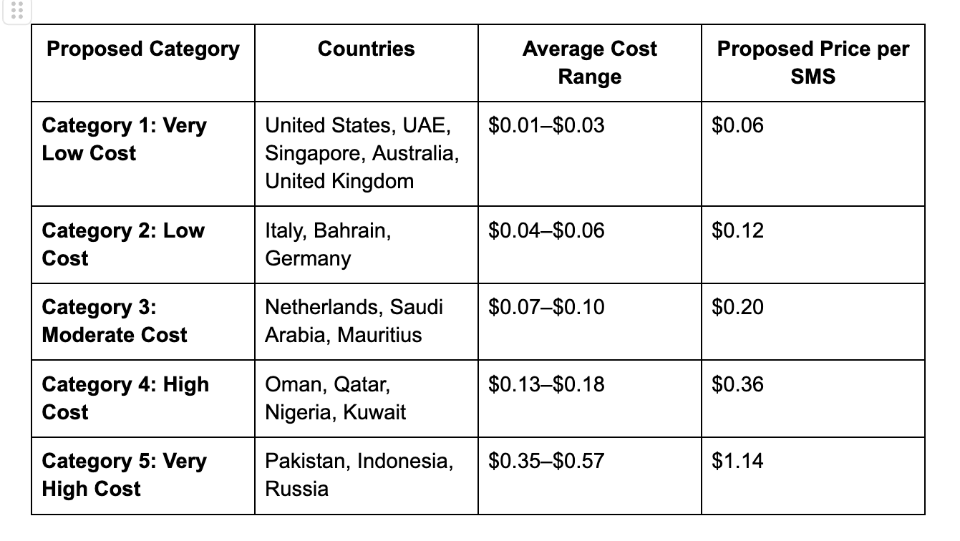
2
Q2b. To evaluate the option involving adjusting fixed-rate category pricing, use the information in Exhibit 11b and propose up to 5 categories to classify the countries listed; indicate the price you propose per message in each category.

Slide 7
2
The proposed prices are designed around Eat App’s goal of earning approximately a 50% gross margin on messaging, meaning the selling price should generally be about twice the underlying SMS cost. The highest-cost country within each category is used as a guide so that Eat App is less likely to lose money within that group. Exhibit 11b shows, for example, that Russia costs Eat App $0.57 per SMS even though customers are currently charged only $0.10, while Pakistan and Indonesia cost approximately $0.35-$0.36 despite a current price of $0.06.
I recommended replacing Eat App’s current two-category SMS pricing system with five categories based on the average cost of sending messages in each country. This approach better aligns customer prices with Eat App’s actual telecom costs and reduces the likelihood of losses in expensive markets. At the same time, using five categories instead of fully variable pricing preserves relatively simple and predictable pricing for restaurants. The proposed pricing of $0.06, $0.12, $0.20, $0.36 and $1.14 per SMS provides a clearer connection between cost and price while helping Eat App move closer to its target messaging margin.
Q2b. To evaluate the option involving adjusting fixed-rate category pricing, use the information in Exhibit 11b and propose up to 5 categories to classify the countries listed; indicate the price you propose per message in each category.

Slide 8
3
Middle East
WhatsApp cost: $0.0244 per conversation
SMS cost: $0.0457 per message
WhatsApp is approximately 47% cheaper
Q2 SMS prices range from $0.06 in the UAE to $0.36 in Kuwait
WhatsApp provides the greatest savings in high-cost SMS markets
Western Europe
WhatsApp cost: $0.0438 per conversation
SMS cost: $0.0348 per message
WhatsApp becomes cheaper when it replaces more than 1.26 SMS messages
One conversation can cover confirmations, reminders, and reservation changes
Two-way communication reduces staff workload and improves customer convenience
Recommendation: Launch first in the Middle East, then expand into Western Europe for reservations that require multiple messages.
Should Eat App integrate WhatsApp as a lower-cost messaging option? If yes, how should it price and package this feature? Use data in Exhibit 11b and 11c, and focus on the Middle East and Western Europe.

Slide 9
3
PROPOSED PRICING
Middle East
• Service conversation: $0.06
• Marketing conversation: $0.09
Western Europe
• Service conversation: $0.10
• Marketing conversation: $0.15
PACKAGING STRATEGY
• Offer WhatsApp as a paid add-on
• Starter: Pay-as-you-go access
• Essential and Pro: One-time trial of 100 conversations
• Pro: Advanced automation and marketing functions
• Prepaid bundles: Maximum 20% discount
• Gross margin before discounts: Approximately 60%
• Gross margin after maximum discount: Approximately 50%–54%
CHANNEL STRATEGY
• Recommend WhatsApp in high-cost SMS markets
• Keep SMS as a fallback channel
• Accept SMS cannibalization when WhatsApp improves contribution margin
WhatsApp complements the five-category SMS pricing strategy and reduces Eat App’s exposure to high messaging costs.
Should Eat App integrate WhatsApp as a lower-cost messaging option? If yes, how should it price and package this feature? Use data in Exhibit 11b and 11c, and focus on the Middle East and Western Europe.

Slide 10
4
Based on the information in Exhibit 12, assess the financial potential of Four Seasons switching to Eat App. How does your recommended pricing factor into the assessment?
Financial Potential
625 covers generated by 6 pilot restaurants over 90 days
Success target: 688 covers (+10%)
Annualized success target: 2,750 covers
OpenTable Pro: $449/month + $1 per cover
OpenTable annual cost:
  Subscription: $22,630
  Cover fees: $2,750
  Total: $25,380
Eat App Pro: $229/month
Eat App annual cost before discount: $16,488
Recommended 20% volume discount
Eat App annual cost after discount: $13,190
Provides Four Seasons with a cost advantage
400 restaurants could create substantial recurring revenue for Eat App
If the Four Seasons pilot succeeds and achieves its targets, how should Eat App structure and price the enterprise deal to entice the hotel chain to switch from OpenTable? Specifically:

Slide 11
4
Should all onboarded restaurants be required to be on the Pro tier, or should flexibility be allowed per restaurant? What volume discount do you recommend? Would you offer further discounts for extending the contract beyond two years?
Enterprise Tier Flexibility & Discounts
Flexible tiers: Restaurants can choose the tier that best fits their size and needs.
Pro: Recommended for larger, higher-volume restaurants.
Essential: Appropriate for smaller restaurants.
20% volume discount across the enterprise agreement.
Additional 5% discount for contracts longer than two years.
Flexibility avoids paying for features that every restaurant may not need.
Longer contracts provide Eat App with more predictable recurring revenue.
Discounts give Four Seasons an additional incentive to commit to Eat App.

Slide 12
4
Integrations & Overall Enterprise Offer
Standard PMS integrations: Include them in the enterprise package because they are important for Four Seasons.
Custom integrations: Charge separately for major custom integrations or extensive development work.
Implementation: Include standard PMS integration and implementation.
Custom development: Charge a one-time implementation fee for highly customized integrations.
Overall offer:
  Flexible tier system
  20% volume discount
  Additional 5% discount for contracts longer than two years
This approach gives Four Seasons a financial incentive to switch while helping Eat App generate recurring revenue and protect profitability.
How should integrations (such as PMS) be handled as part of the offer?

